Slide 1

Prof. V.B.Shah Institute of Management & R.V. Patel College of Commerce (Eng. Med.) & V.L. Shah College of Commerce (Guj.
Med.) & Sutex Bank College of Computer Applications & Science. Veer Narmad South Gujarat University , Surat.
Minor Project Report
On
Business Consulting App
For
Subject : 501 – 02 Advanced Mobile Computing
Submitted By : Gabani Pal Nanjibhai
Roll No. : 604
Exam No. : 5170
Guided By : Ms. Jigisha A. Patel

Slide 2
The Business Bridge

Slide 3
Introduction
Are you ready to unlock a world of business ?
Navigate the turbulent waters of business with confidence using our cutting-edge consulting app.

Slide 4
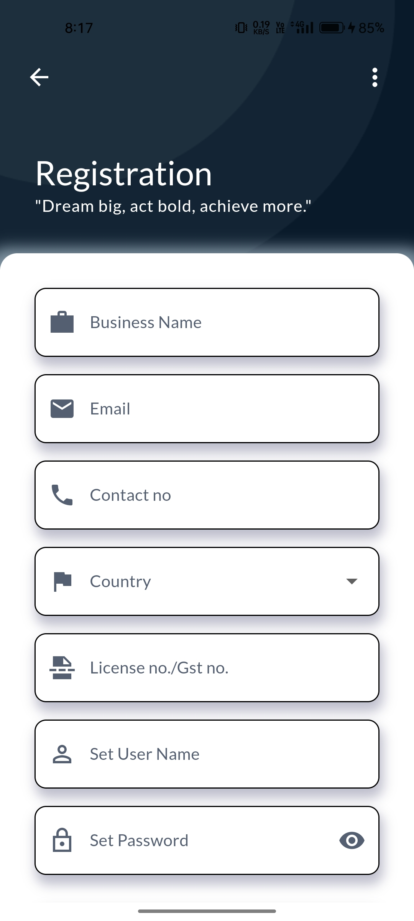
Sign in
user can signup through this page.
By felling all the information which are required user successfully singup to application .

Slide 5
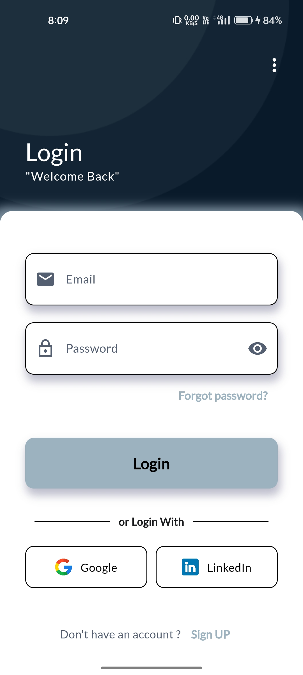
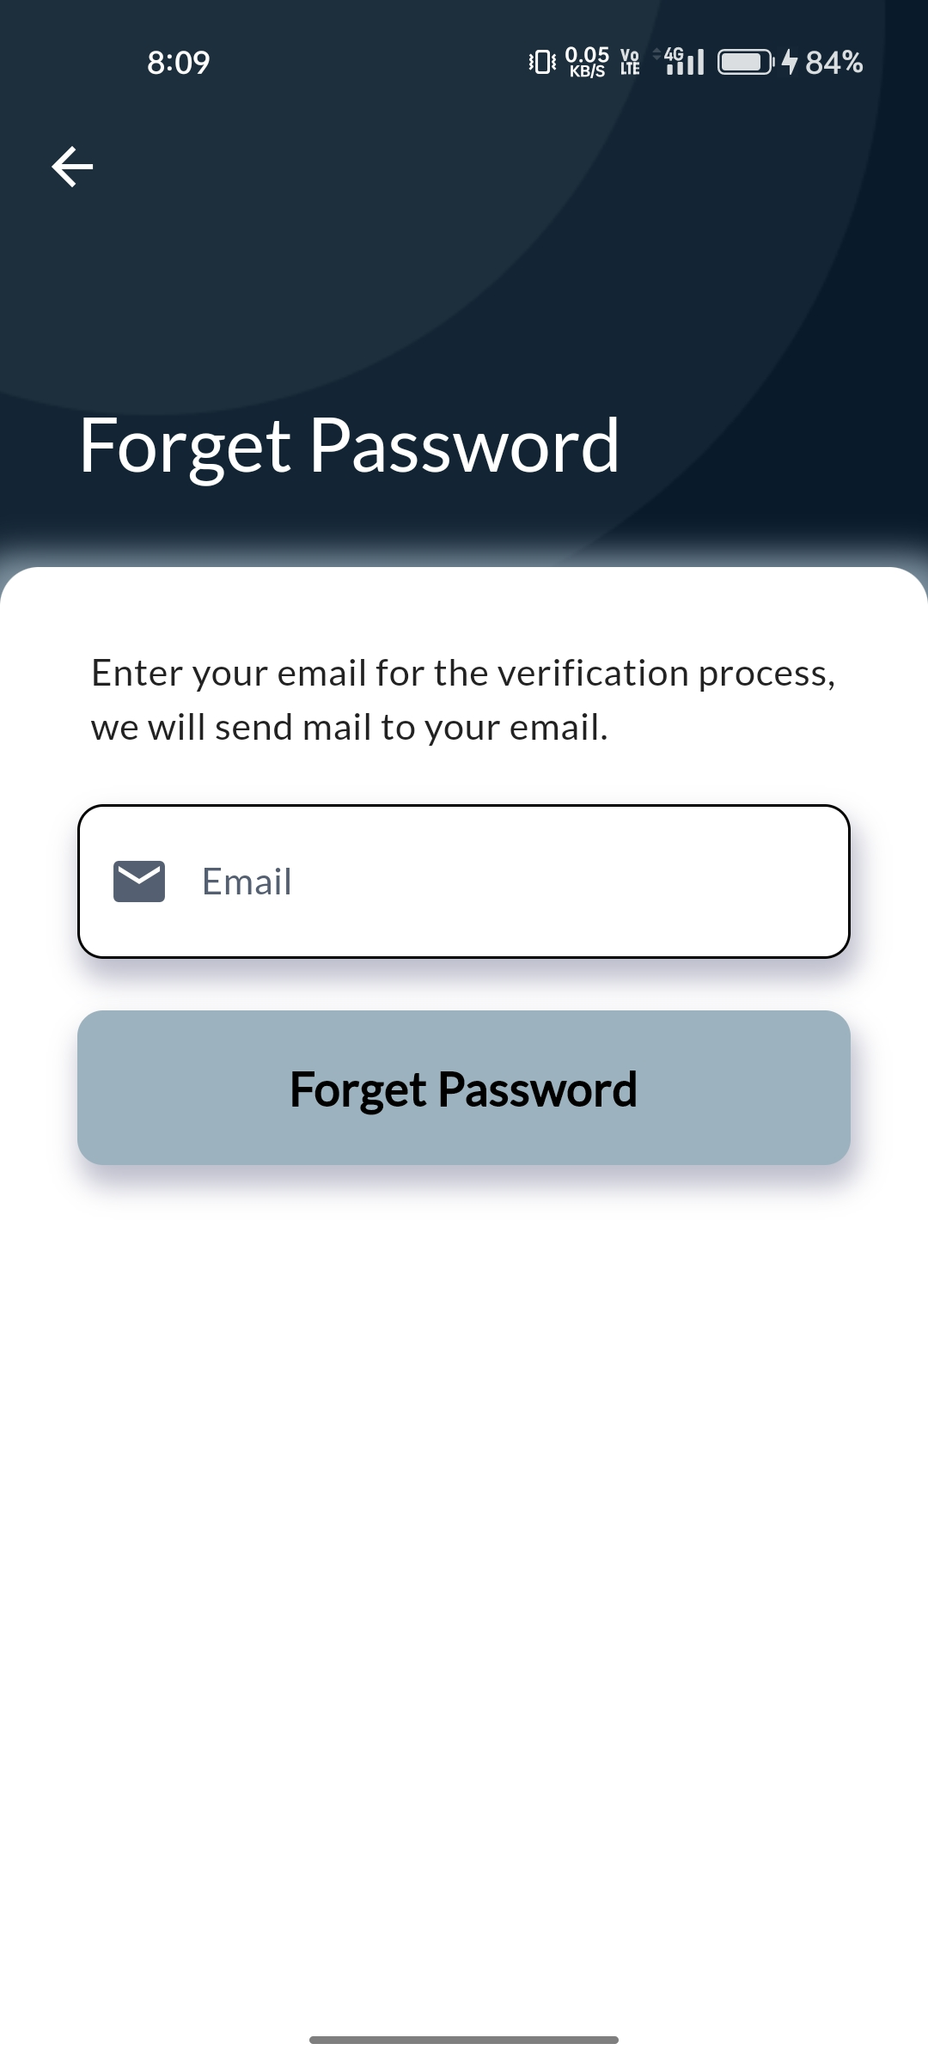
Log in
user can Login to application through email and passward.
By Felling those information user logging successfully to application .

Slide 6
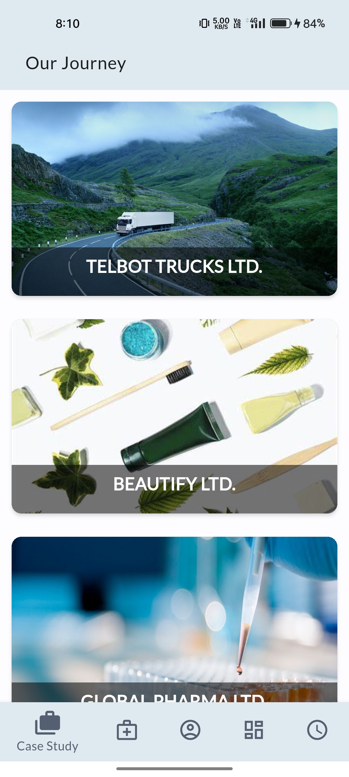
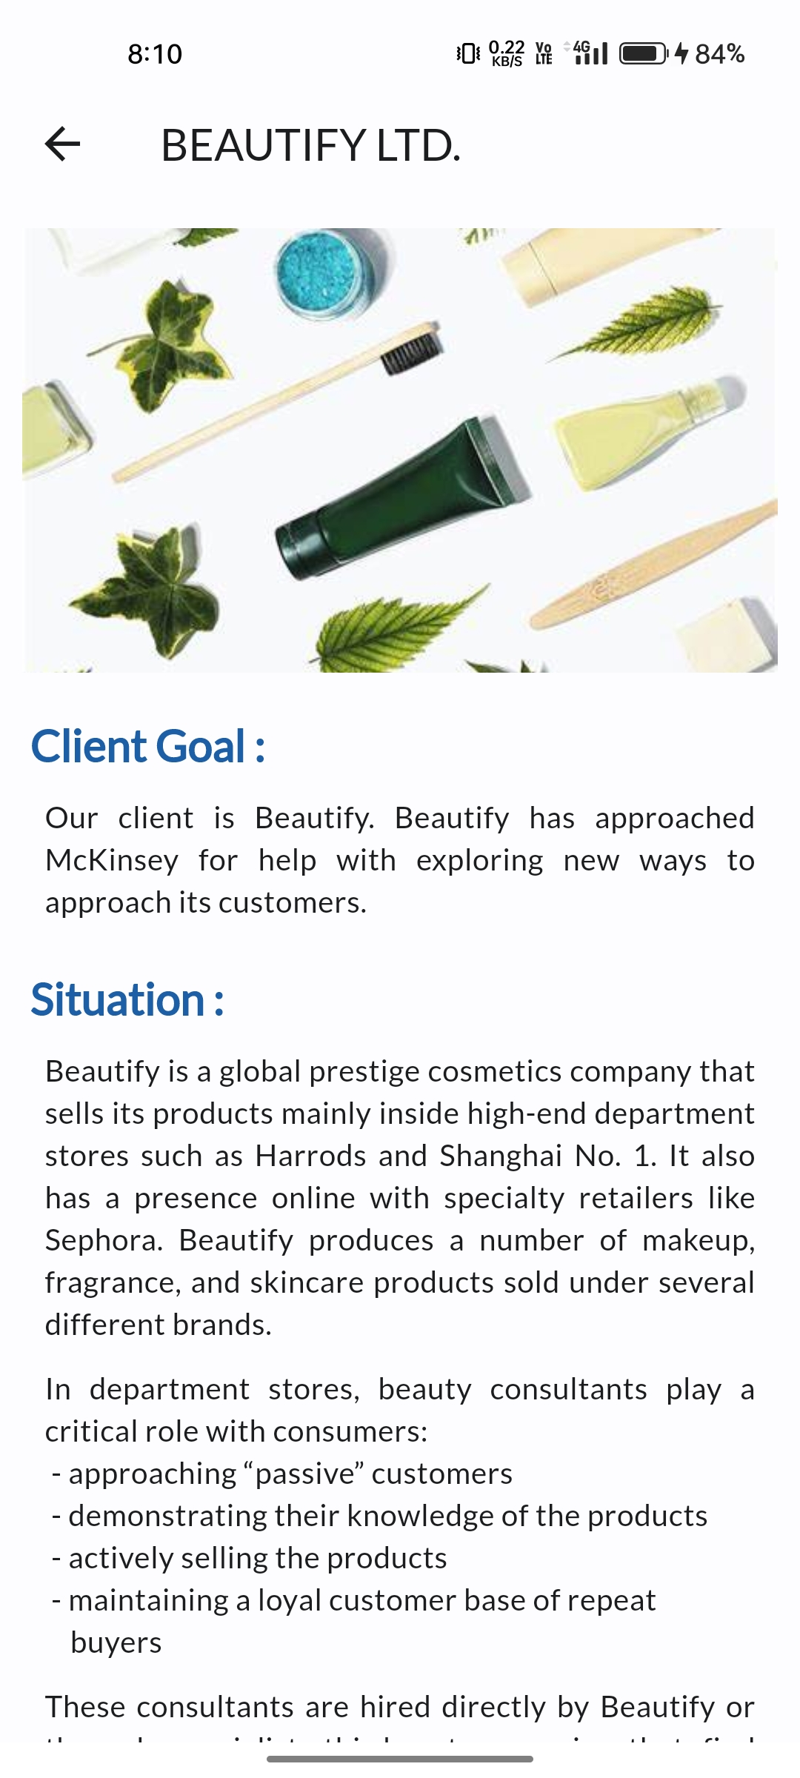
Case Study
A case study page typically presents in-depth information about a specific project, situation, or success story.
Case studies are used to showcase a company's expertise.

Slide 7
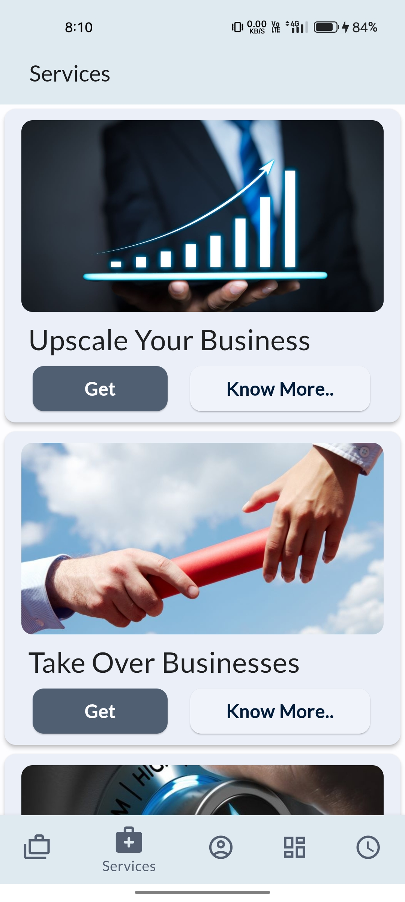
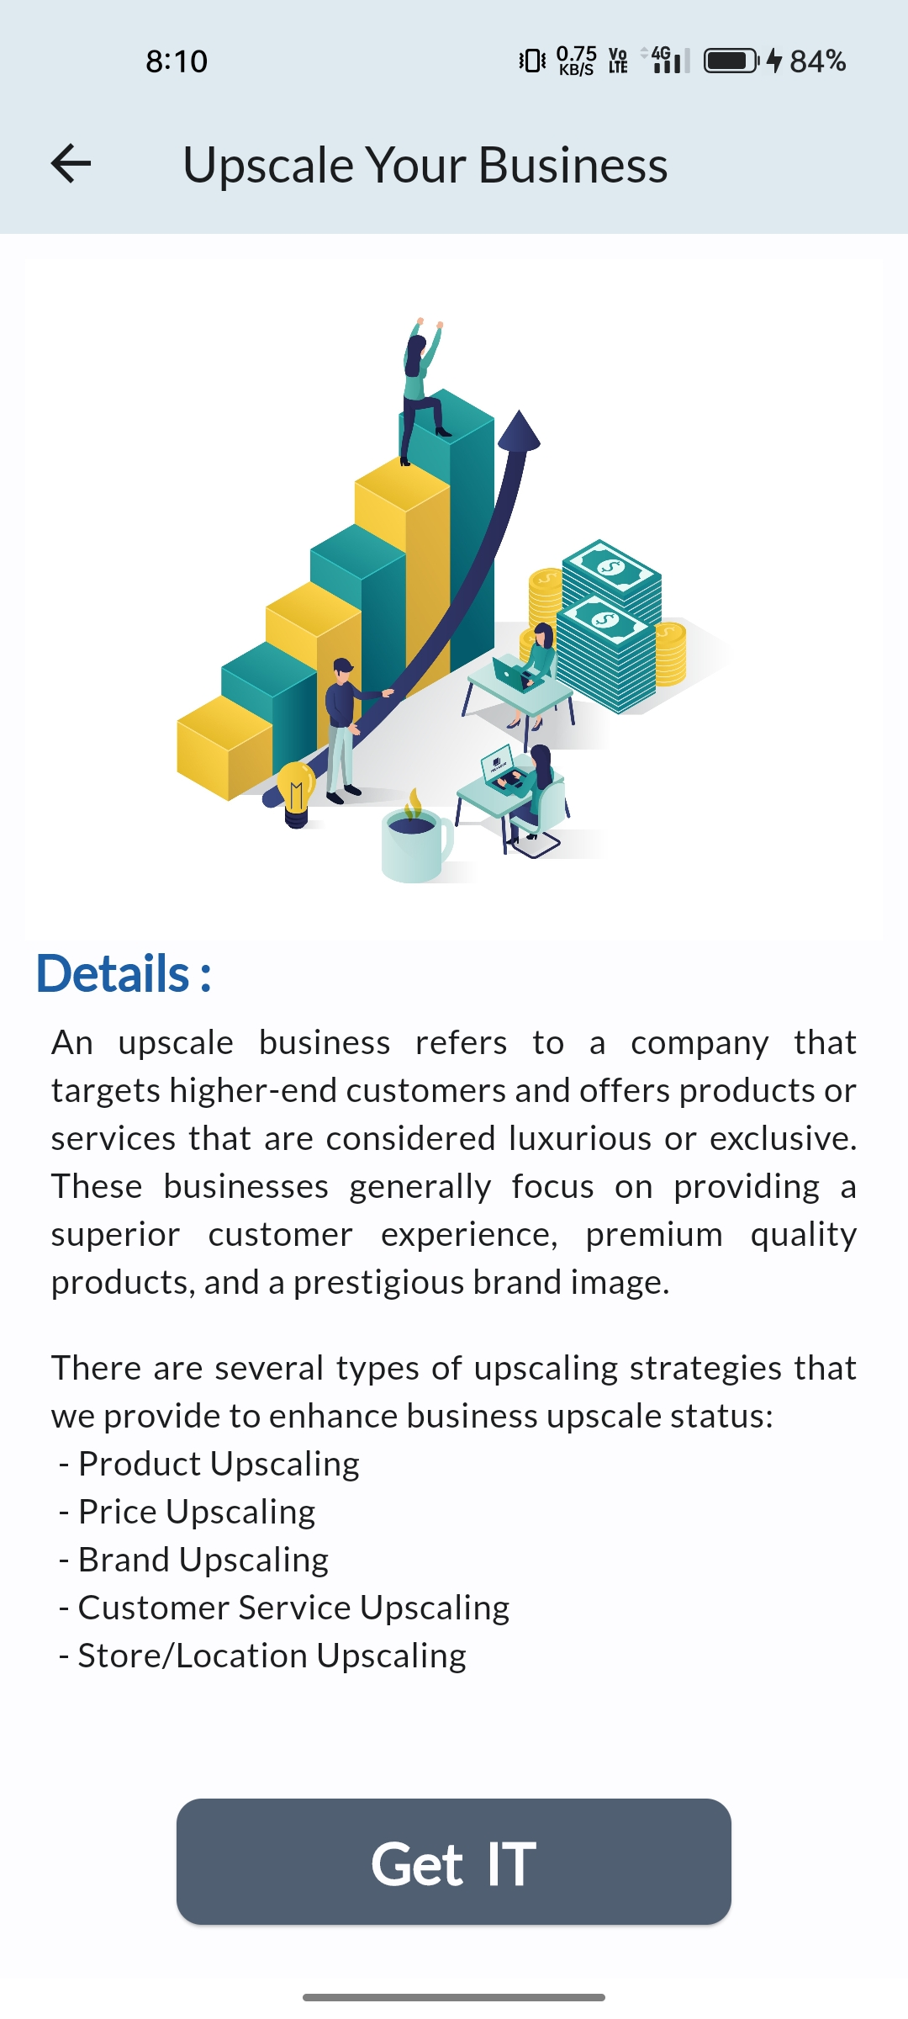
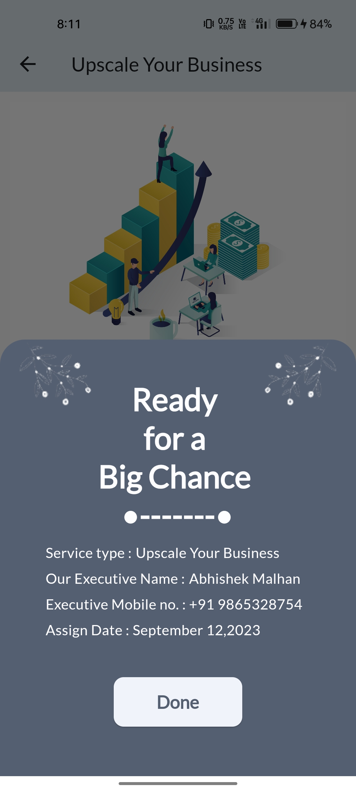
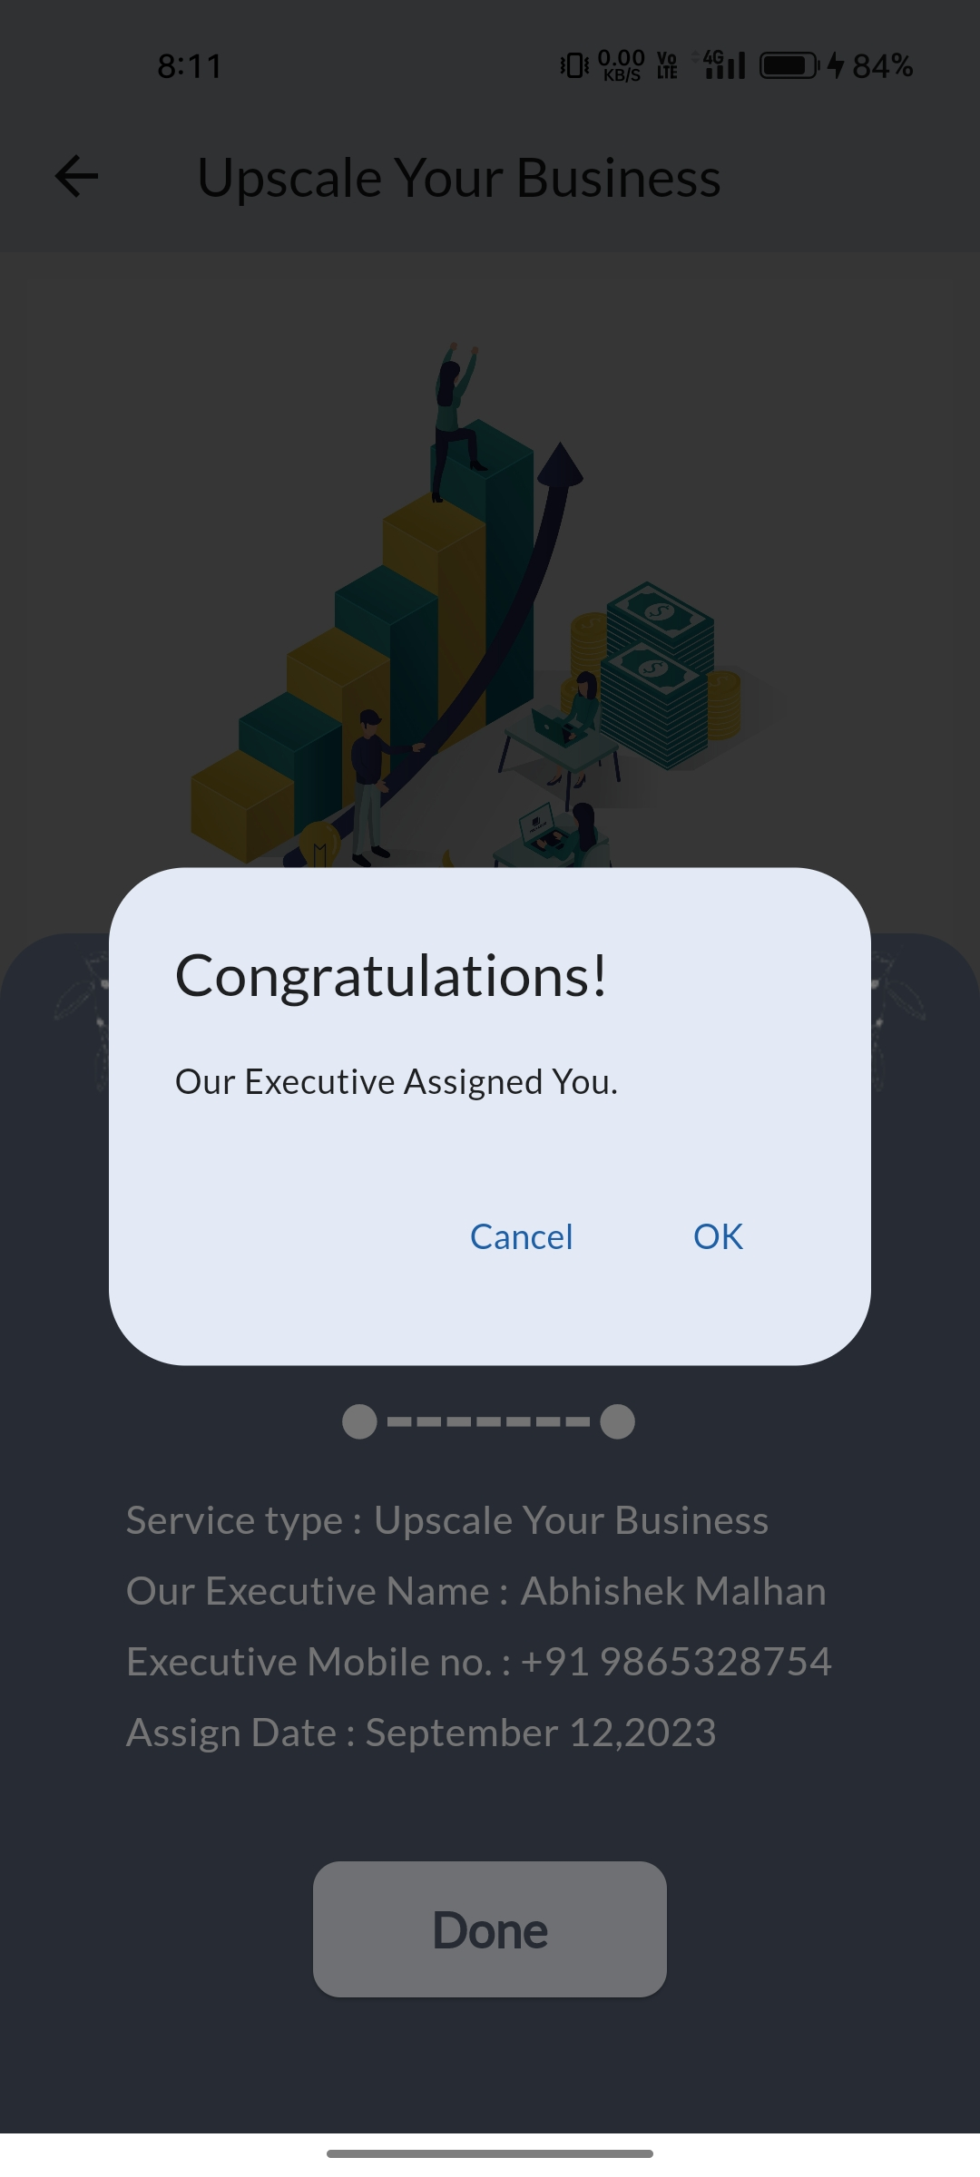
Service Page
A service page in an app provides comprehensive information about the services offered.
It includes descriptions of each service, pricing if applicable, key features, and benefits.

Slide 8
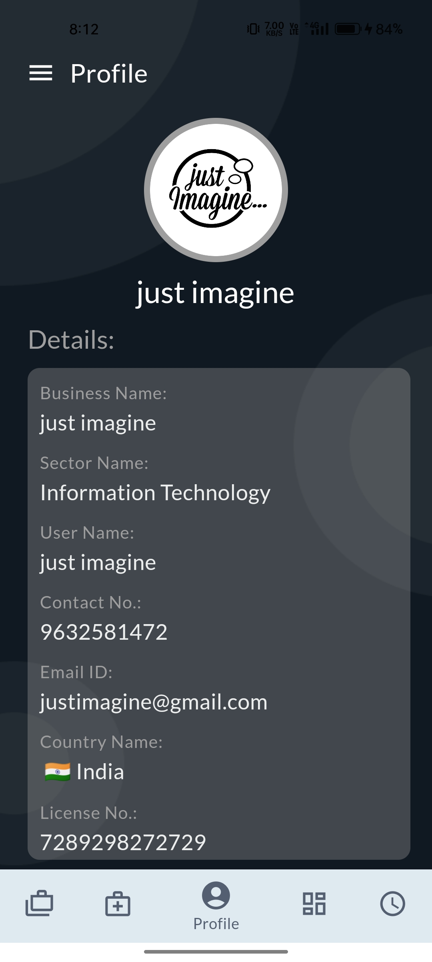
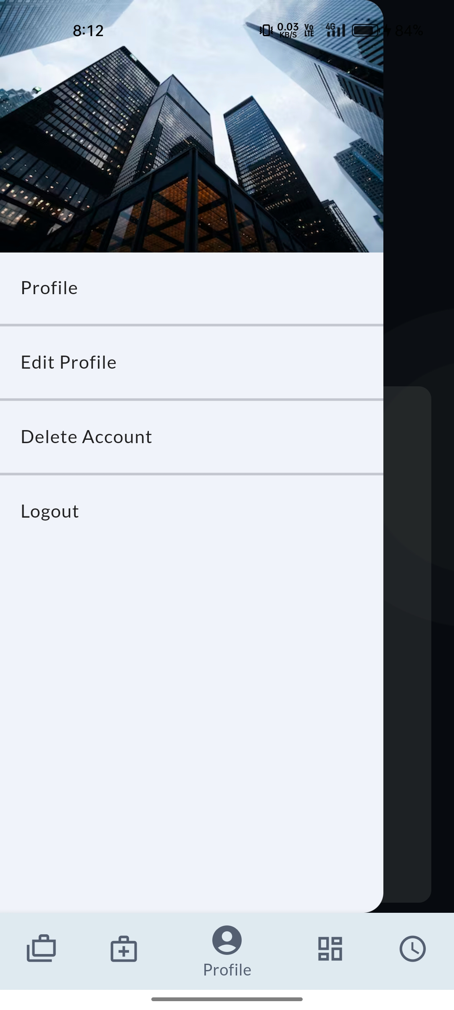
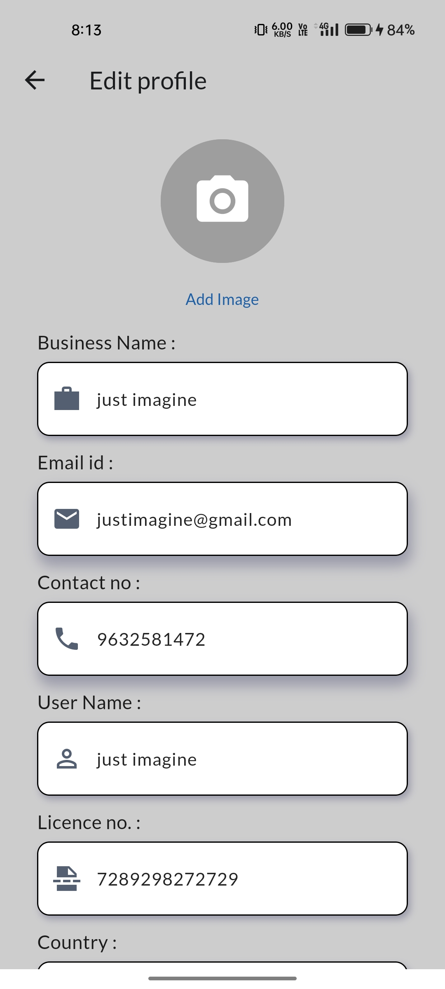
Profile Page
A business profile page in an app showcases essential information about a company.
It typically includes the business's name, logo, contact details, a brief description, operating hours, and a link to their website or social media profiles.

Slide 9
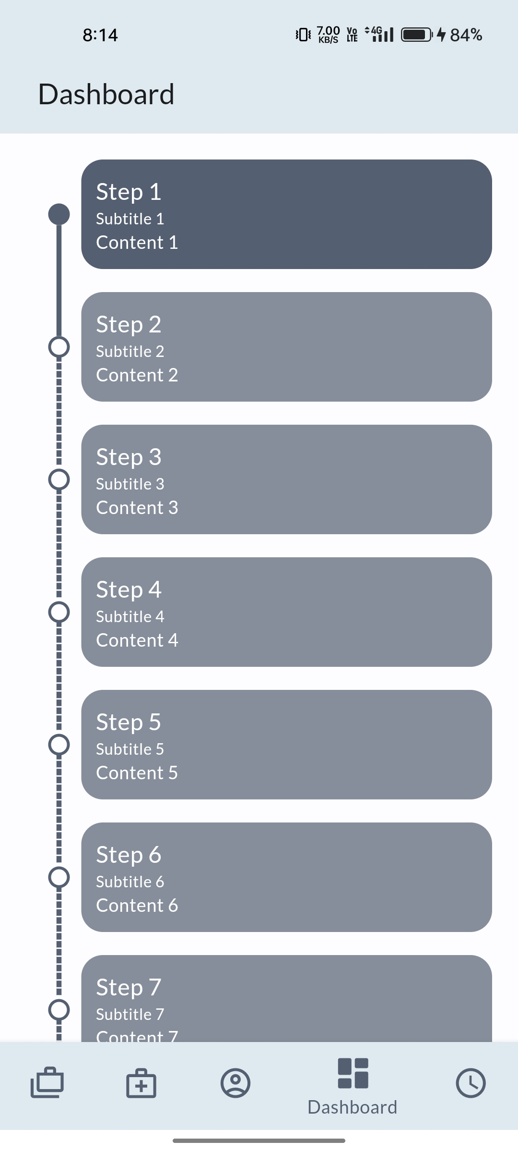
Dashboard Page
A dashboard page in an app serves as a centralized hub for users.
It offers a visual overview of important data and features such as graphs, charts, or statistics related to the app's core functionality.

Slide 10
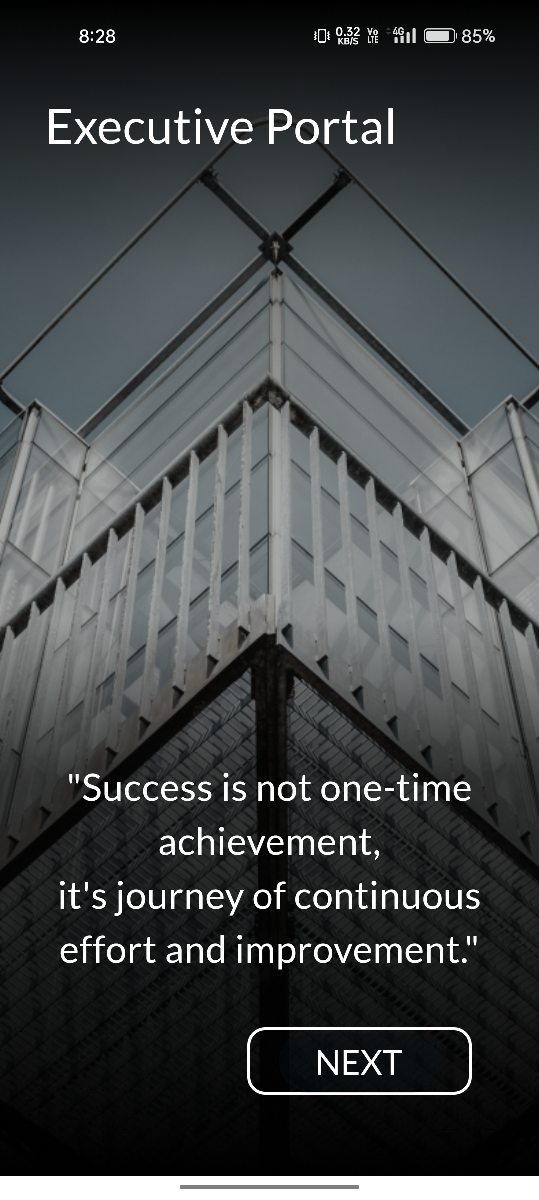
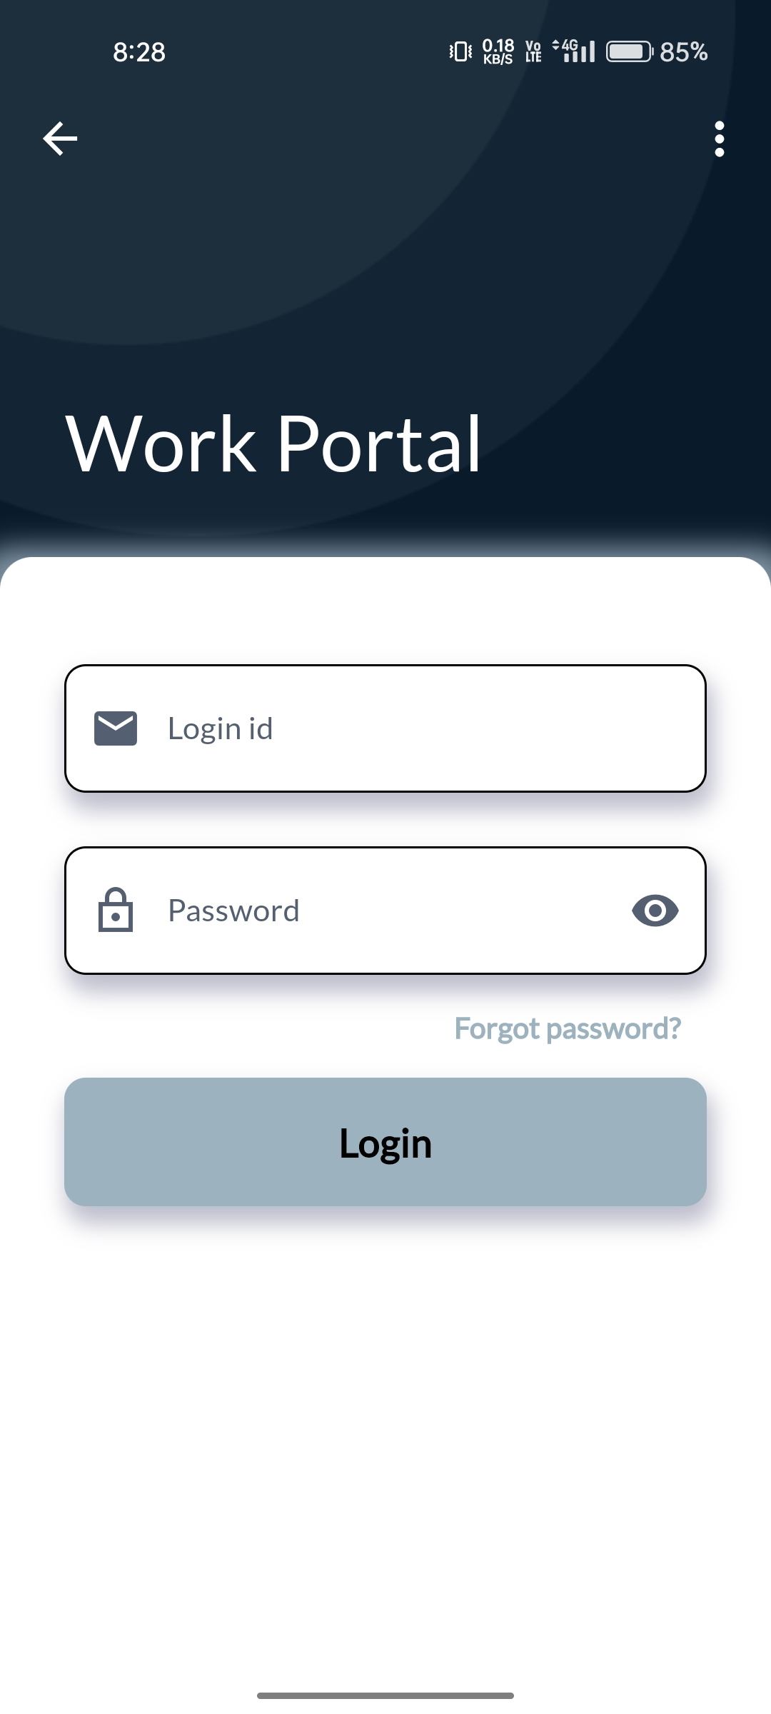
Executive Log-in Page
An executive login page in an app is a secure access point for high-level users.
Executives typically enter their unique credentials, such as a username and password, to gain access.

Slide 11
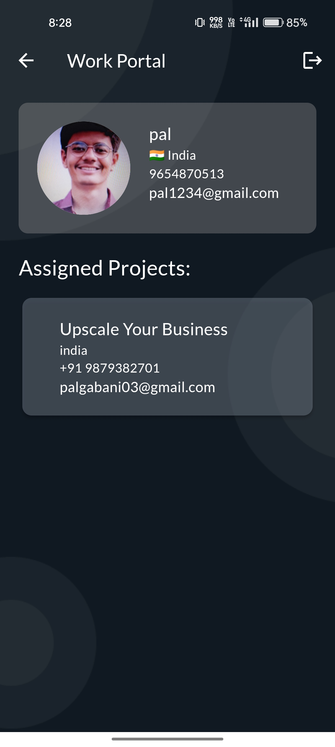
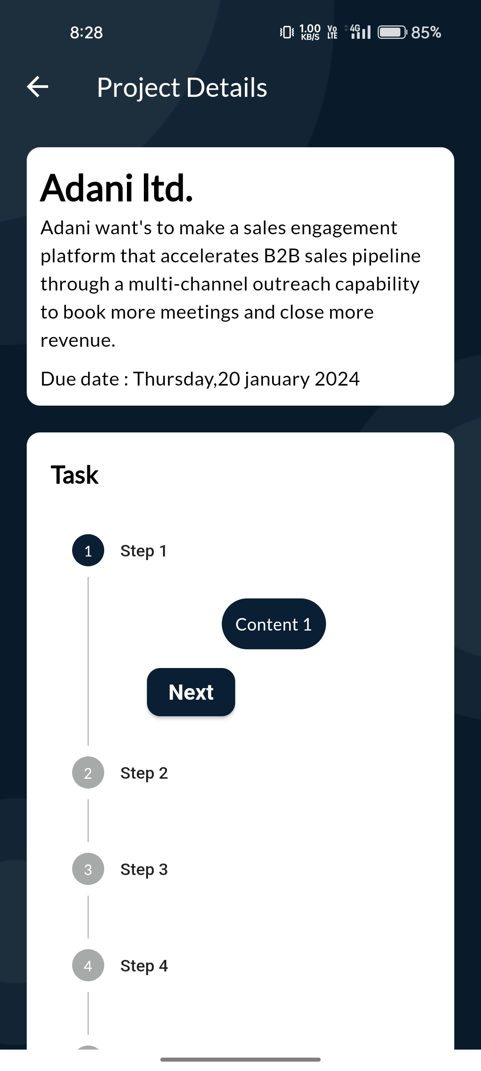
Executive Work Portal
An executive work portal is a comprehensive digital platform designed to streamline tasks and information access for top-level professionals.

Slide 12
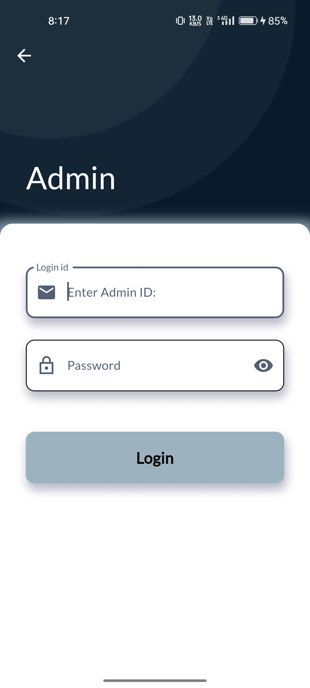
Admin Log-in Page
The app admin login process is a secure gateway for authorized administrators to access the app's backend and manage its functions.
Admins typically navigate to a dedicated login page where they input their unique credentials.

Slide 13
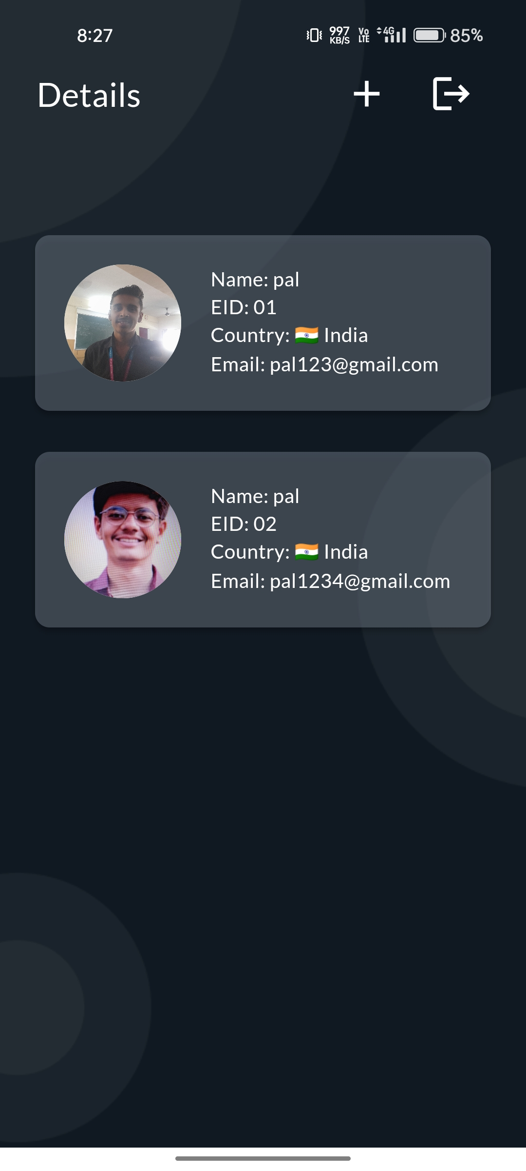
Executive Details Page
The app executive details page is a feature that provides comprehensive information about high-ranking individuals within an organization.

Slide 14
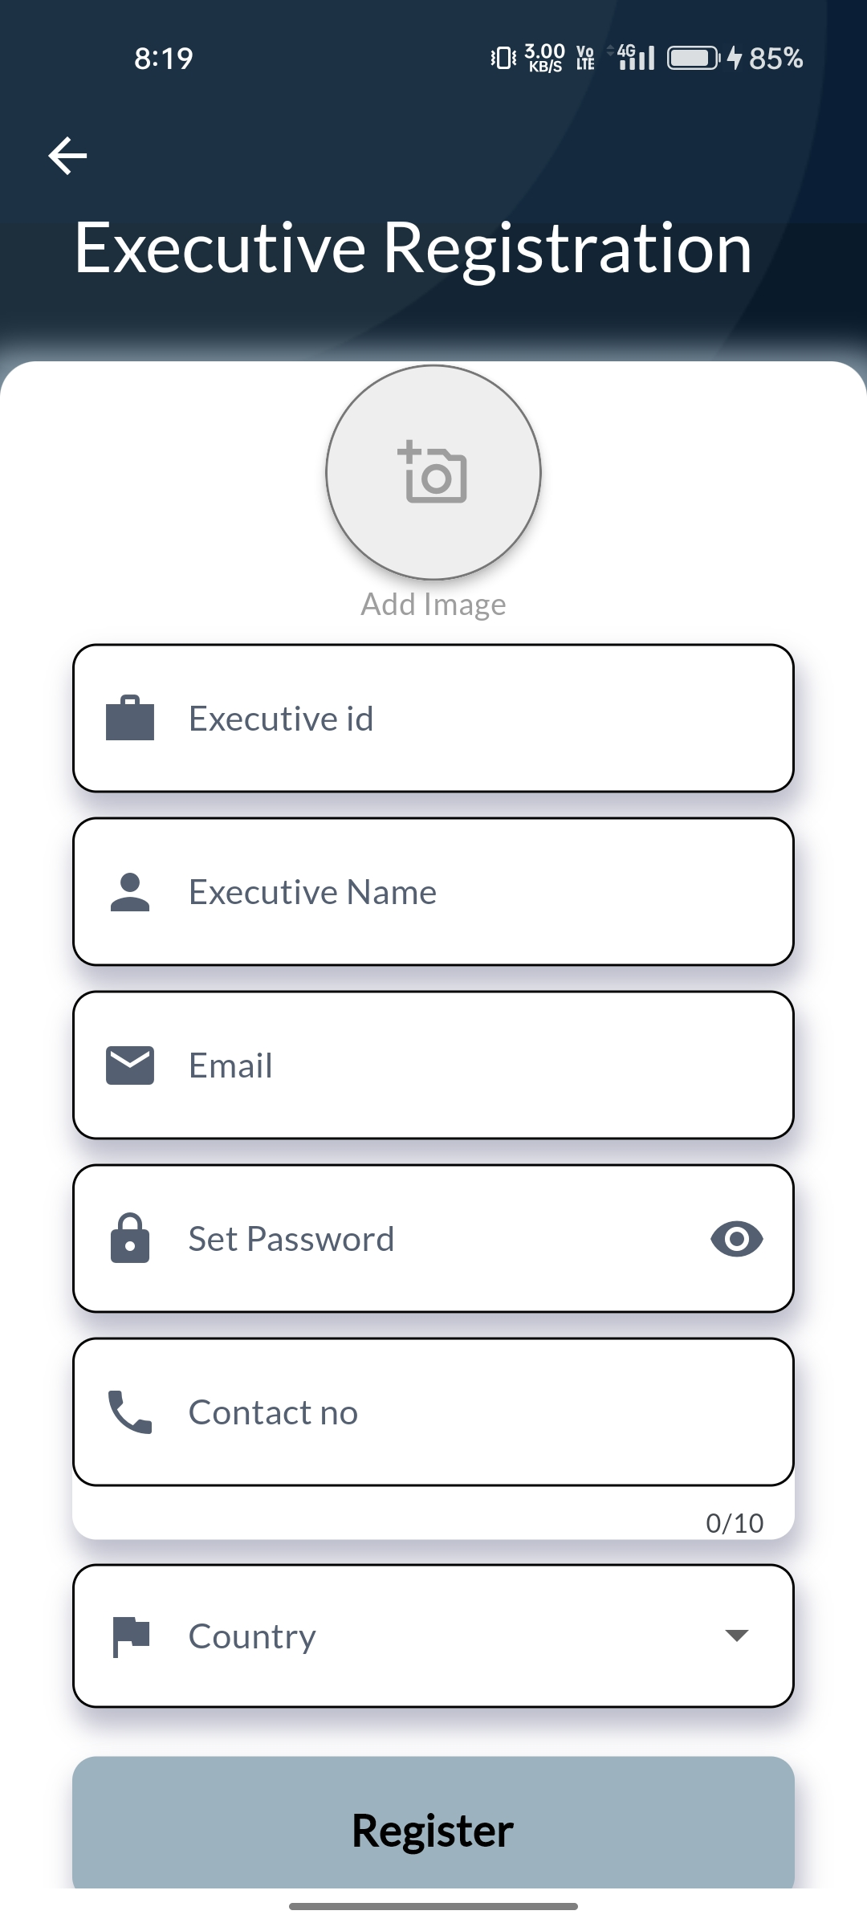
Add Executive Page
The executive details page process provides users with essential information about high-level executives within an organization.
Users typically access this feature by logging into the app and navigating to a dedicated section or using a search function.

Slide 15
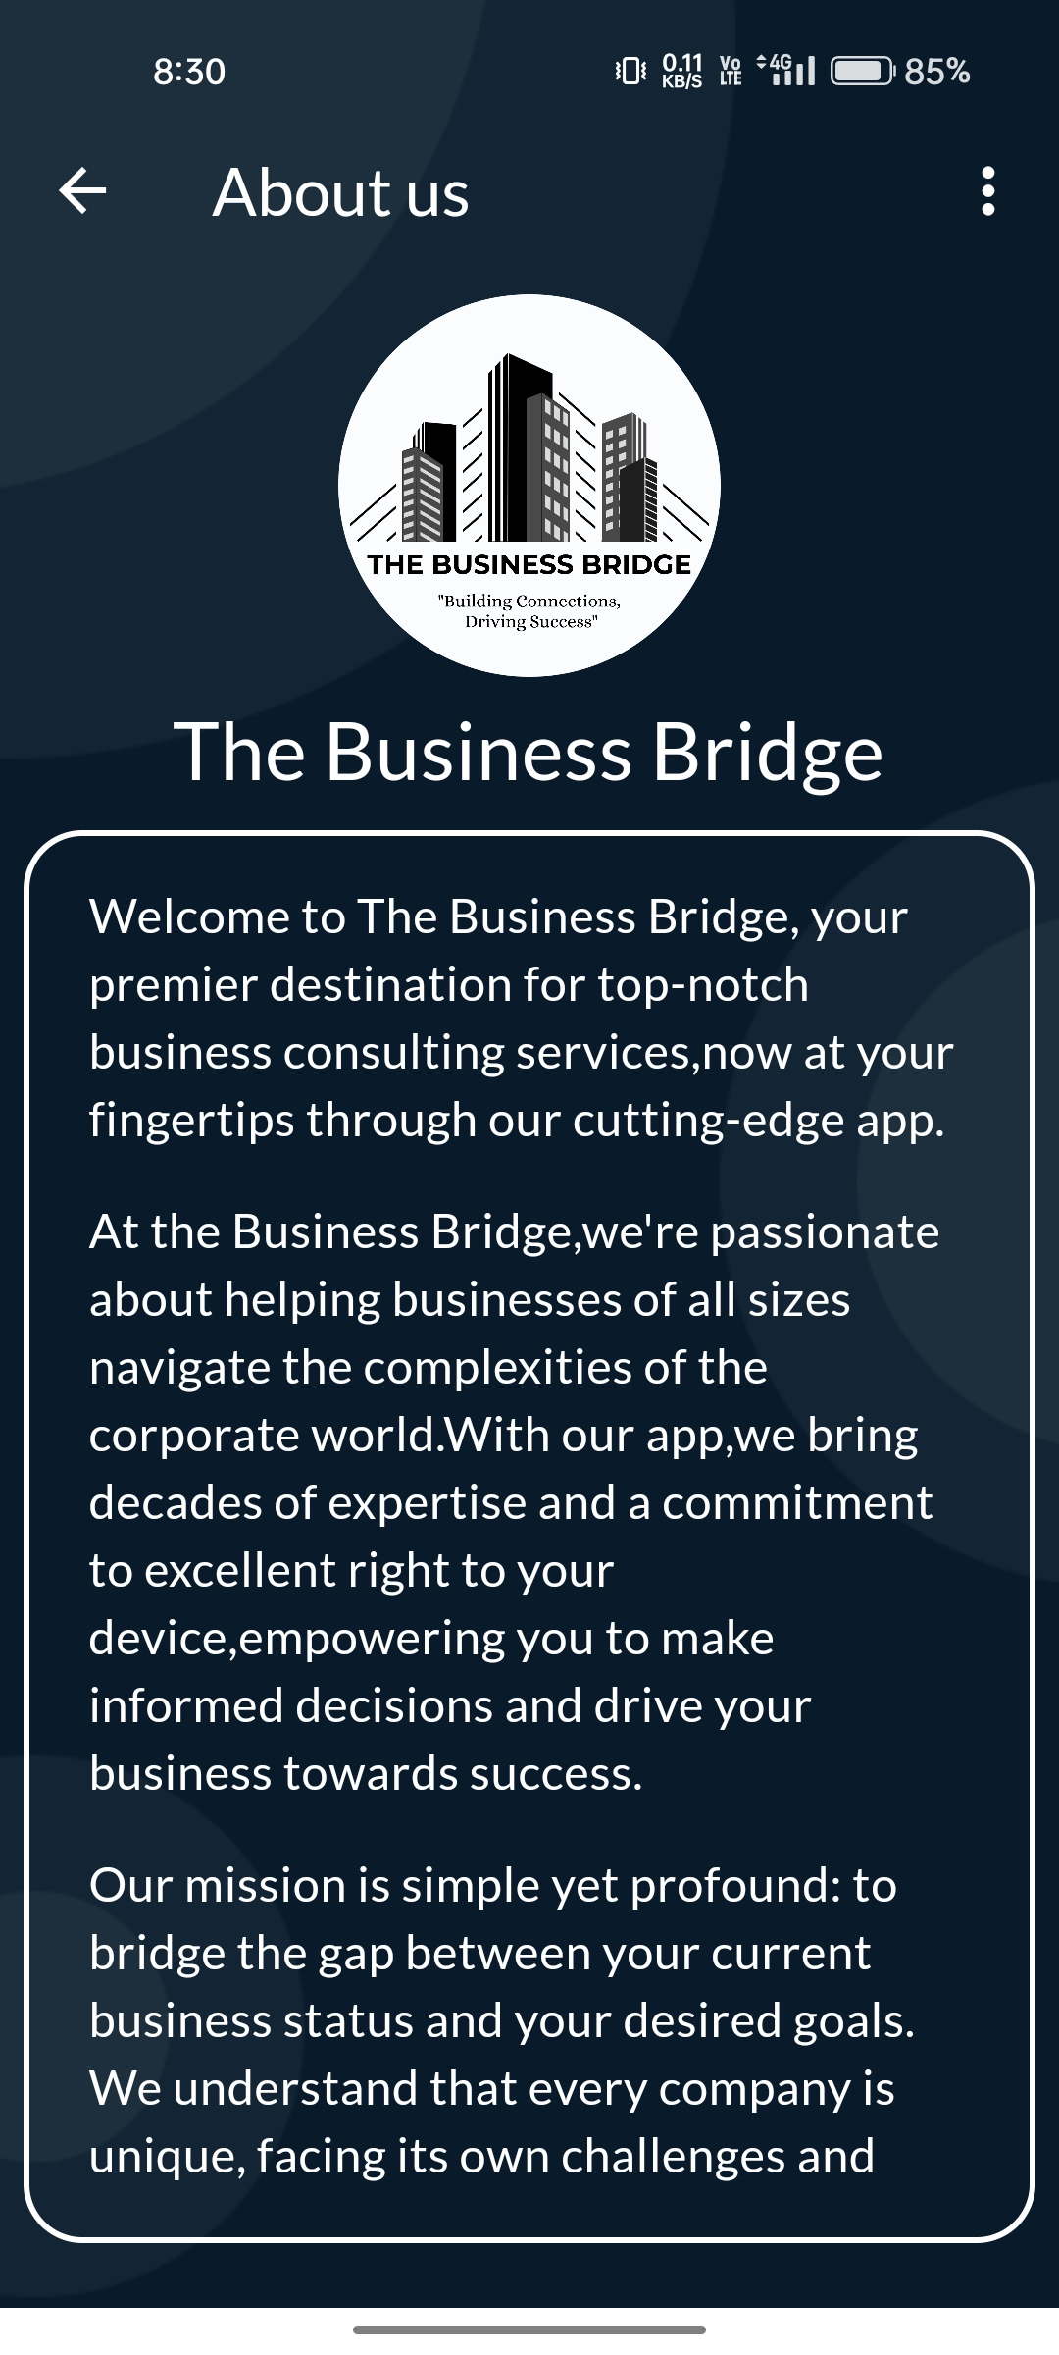
About Us
This page provides concise information about the app and its creators.
It typically includes a brief overview of the app's purpose, features, and benefits.

Slide 16
THANK YOU

